Slide 1
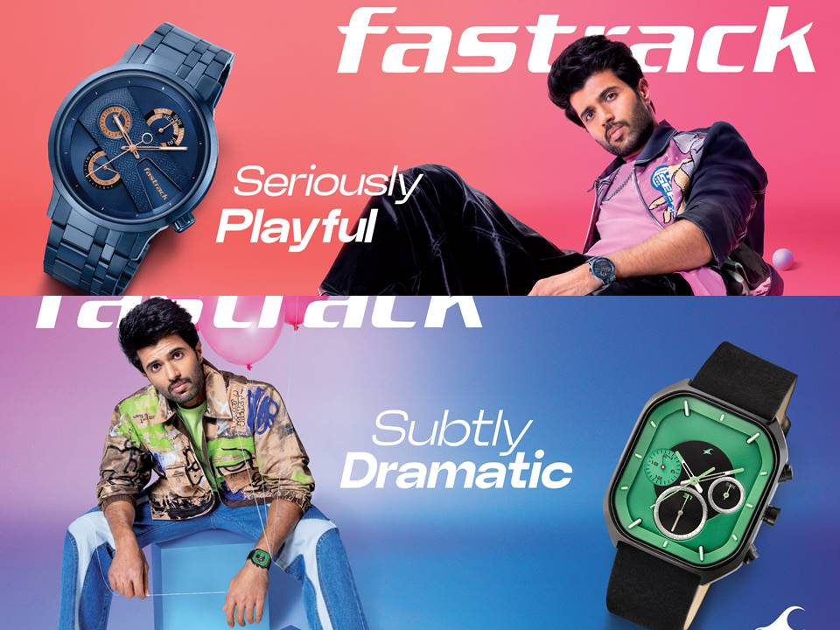
FASTRACK
The word “Fastrack” implies speed and efficiency, while the word “BeBoth” suggests duality and contradiction. Together, these two words create a powerful message about the importance of being flexible and adaptable in a rapidly changing world.20 Sept 2023
Fastrack launches actor Vijay Devarakonda as Brand ambassador, with a Fashion First take on youth.1 Sept 2023

